Slide 1


Sprint 2
By: CDTs Gohar, Gover, Nguyen, Placke and Valle
Product Owner: LTC Craig Boucher
Faculty Advisor: LTC James Finocchiaro

Slide 2
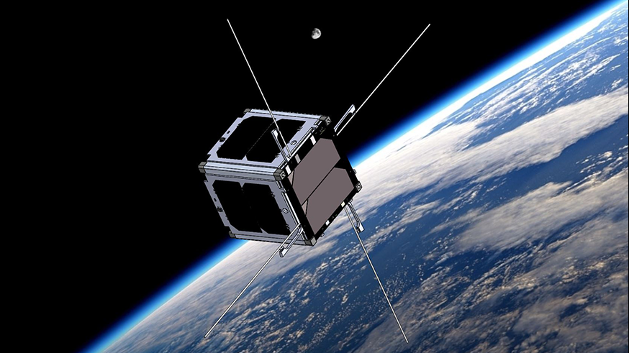
Brief overview of the project
Five year program from SMDC
Universal compute module to be used in many sub-models
Military in nature: assist in defense, and gathering information
Outcomes: command data handling systems, TT&C, and power

Slide 3
Sprint Goal
Potential operating systems will be researched in order to determine the best fit for our Cubesat in addition to refining our product matrices.

Slide 4
Sprint Hours
Label | Planned Hours | Actual Hours
Knowledge Acquisition | 46 | 46
Work Environment Setup | 4 | 10
Requirements Generation | 51 | 53
Design Diagramming | 6 | 23
Project Communication | 14 | 14
Allocated Time: 121
Actual Time: 140

Slide 5
Demonstration of Results
Trello with Burndown Chart
OS research
CubeSat design mock-up
Updated block diagram
System Power Requirement Chart

Slide 6
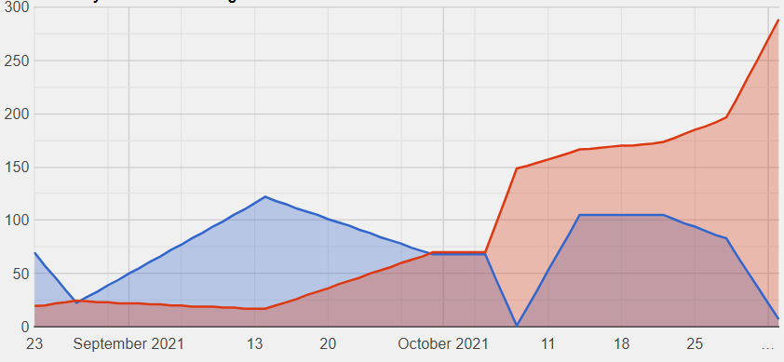
Trello Burndown Chart

Slide 7
OS Options
Salvo from Pumpkin
CubedOS
Robot Operating System (ROS)

Slide 8
Salvo from Pumpkin
RTOS
Programmed in C
Low RAM requirements
Easily scalable

Slide 9
ROS
Not real time
Built on C++ and Python
Has many libraries useful to cubesat systems
Would require quite a bit of work to integrate for a cubesat, as it is designed for robotic systems.

Slide 10
CubedOS
RTOS
Programmed in Spark
Built off of NASA Goddard’s cFE system (has capability to integrate flight control systems)
Designed to be incredibly modular (supports the integration of payloads)
Open source

Slide 11
Updated Specifications and Constraints
Constraints
CubeSat will be contained within a 10x10x10cm structure (U1 cube)
CubeSat will be under 5kg
Radiation shielding for CPU capable of protecting CPU from high earth orbit levels of radiation
OS functionality with allocated RAM
Specifications
High Frequency and X band capable transceiver array
Communications array capable of comms up to 36,000 km
Two Raspberry Pi CPU’s which can reset each other in case of error
Command Line interface
Universal interfaces for sensors
***power specs***
Real Time OS utilizing a FIFO Queue

Slide 12
Final Parts Choices
GPS/GLONASS receiver SX-NAV-03
TI TMP117
EnduroSat UHF Transceiver II
Cubetorquer and CubeCoil
Raspberry Pi Compute Module
The NanoPower P31u
Endurosat Solar Panel

Slide 13
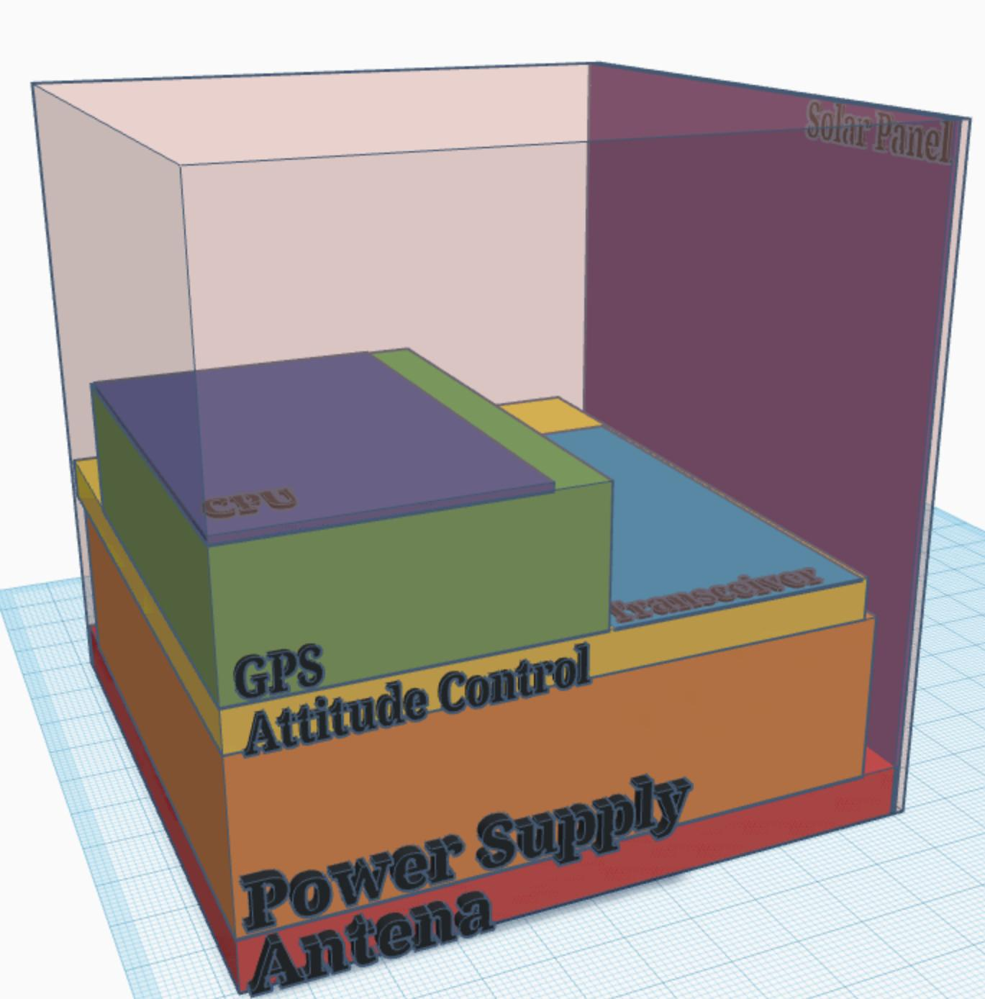
CubeSat design mock-up

Slide 14
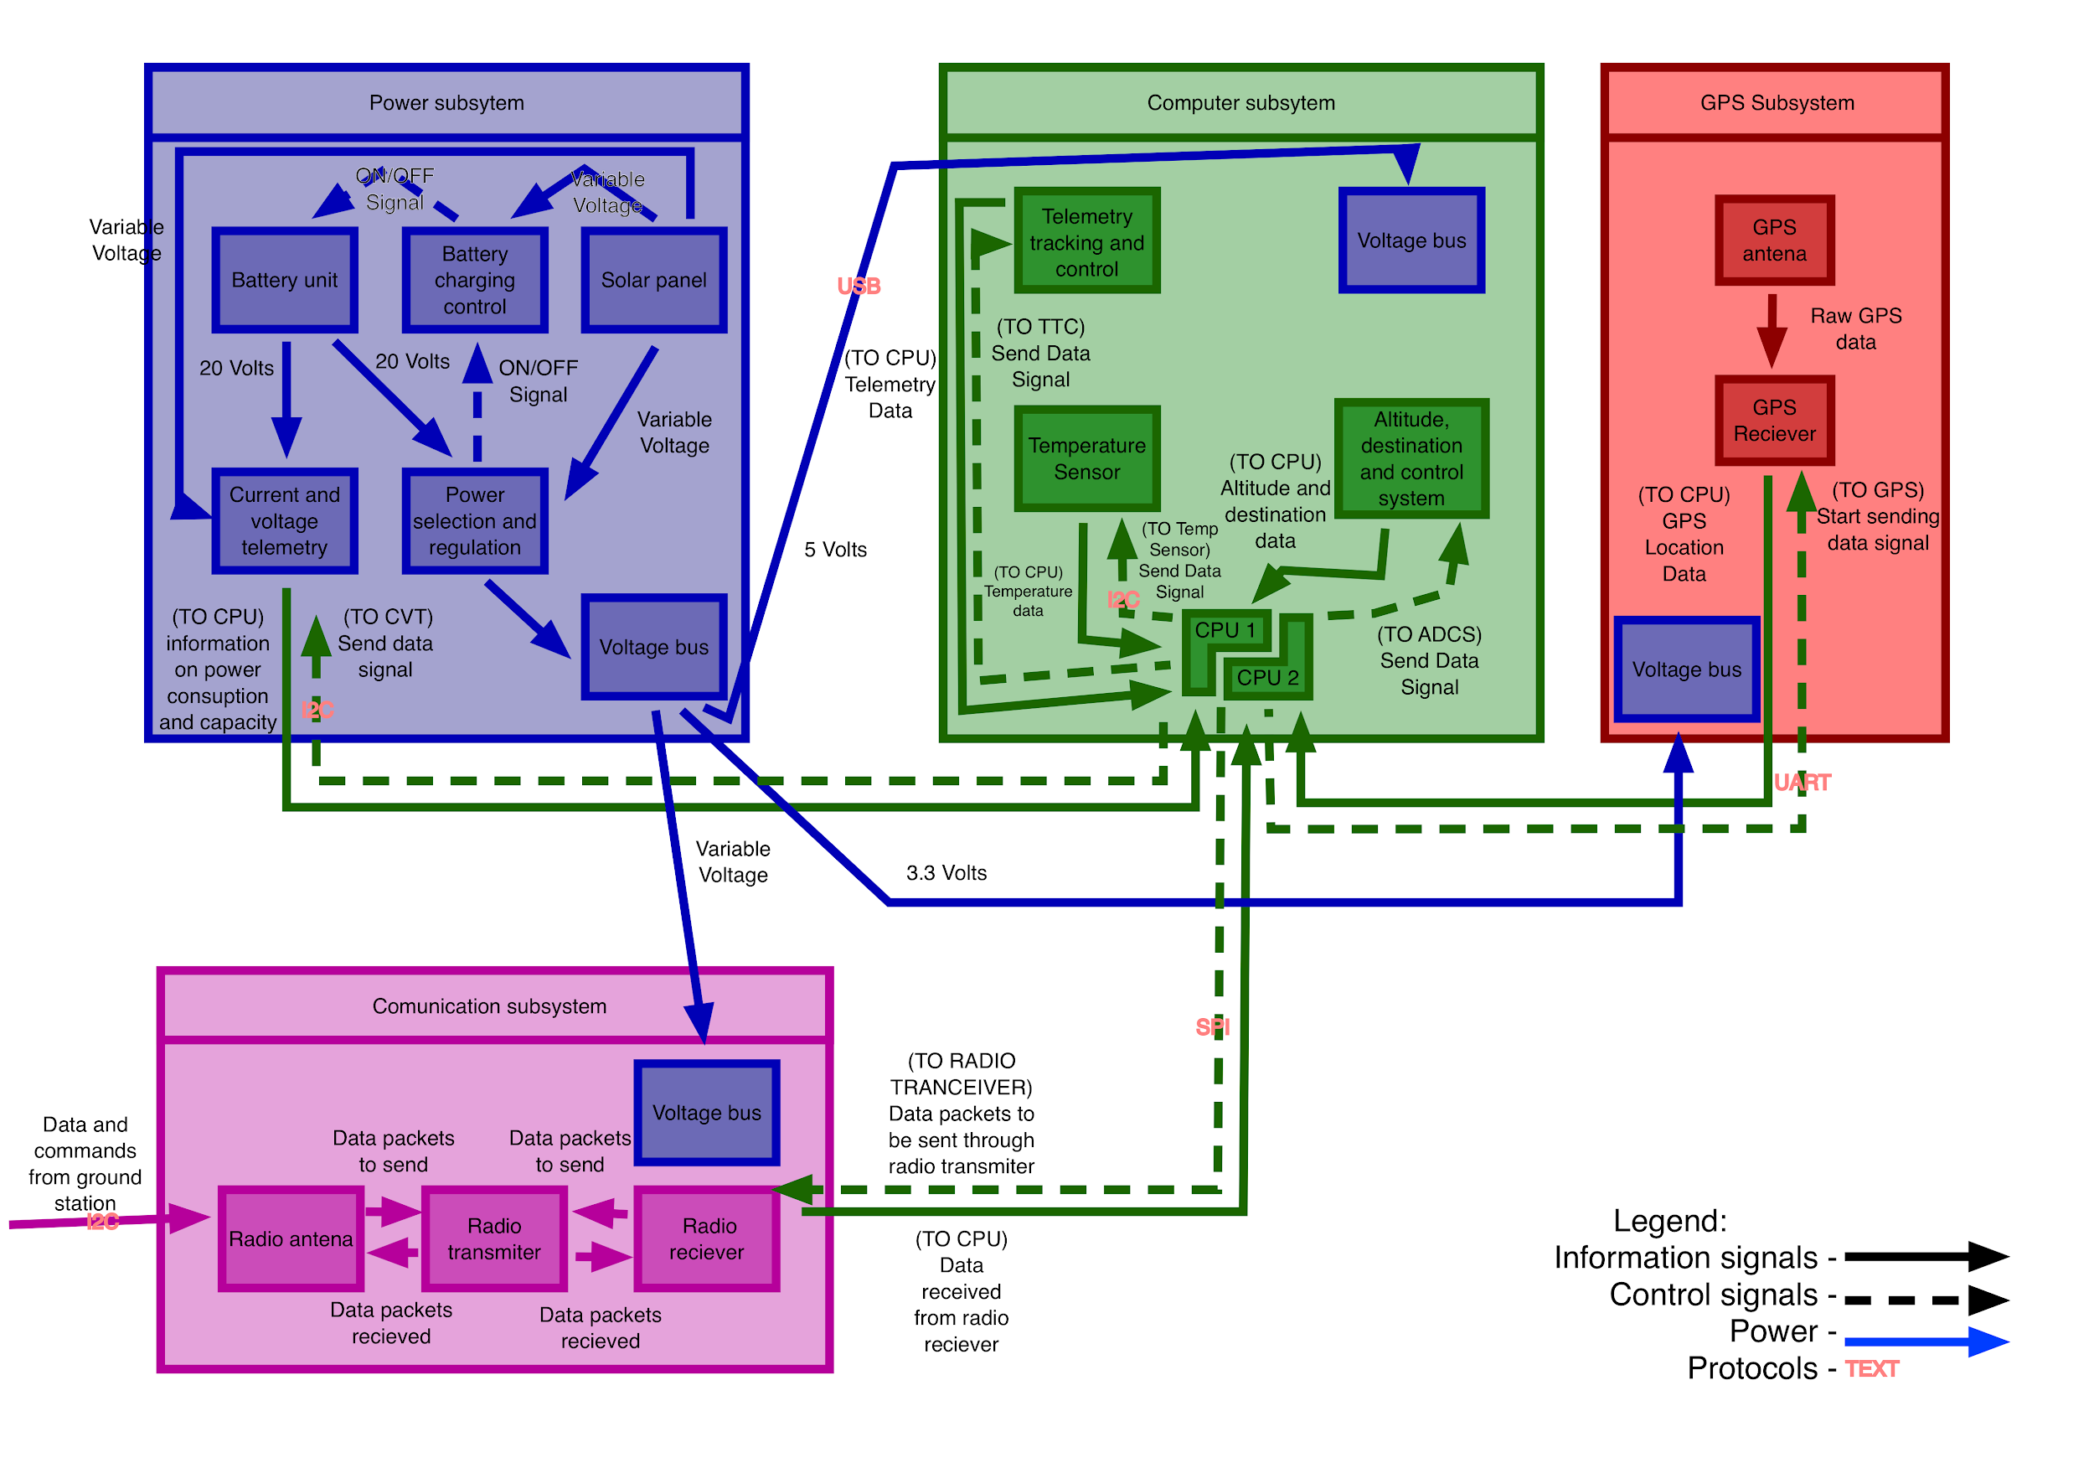
Updated block diagram

Slide 15
System Power Requirements
Component | Voltage (V) | Current (A) | Power (W) | Duty Cycle (%) | Total Power (W) | Contingency (%) | Grand Total (W)
Temp Sensor | 5.00 | 0.01 | 0.03 | 100% | 0.03 | 30% | 0.03
GPS | 3.30 | 0.56 | 0.10 | 100% | 0.10 | 5% | 0.11
Antenna | 5.00 | 0.40 | 2.00 | 100% | 2.00 | 10% | 2.20
transceiver | 5.00 | 0.40 | 4.00 | 100% | 4.00 | 10% | 4.40
Altitude contoler | 5.00 | 0.40 | 0.10 | 100% | 0.10 | 10% | 0.11
CPU | 5.00 | 0.54 | 2.70 | 100% | 2.70 | 30% | 3.51
Total | 6.74 | W
Time to Run | 2.00 | hours | 90 minutes to orbit the earth | 0.3333333333 | Margin
Energy Used | 13475.00 | mWh
Battery Capacity | 20000.00 | mWh
Margin | 48.42%

Slide 16
Recommendations for next sprint
In order to image our CubeSat with the operating system we choose, we have to become more familiar with hardware
We will have to become familiar with the coding language Spark ADA as that is the language our OS runs
Become more familiar with the data structures in Spark so our OS can handle a data stream to send to the ground station

Slide 17
XE401/2 Product Roadmap
Product Roadmap | Sprint 1 (8 OCT 2021) | Sprint 2 (3 NOV 2021) | Sprint 3 (7 DEC 2021) | Sprint 4 (~7 FEB 2022) | Sprint 5 (~25 MAR 2022) | Sprint 6 (~24 APR 2022) | Sprint 7 (~14 Jun 2022)
Sprint Goal (abbrev) | Develop a functional block diagram which will layout the components in the CubeSat and a parts matrix. | Operating systems will be researched in order to determine the best fit for our Cubesat in addition to refining our product matrices. | CubeStar OS will be imaged to Raspberry Pi and will be able to handle compiling the data stream into a succinct package. | After receiving the components, a prototype table-top model will be developed. | The prototype Cubesat will be ready for in flight testing and balloon sat testing. | The Cubesat will be prepared for a Projects Day presentation to include presentation materials. | The Cubesat team will develop a paper to be published.
Major Feature Additions | Component List Functional block diagram Establishment of Github repo and Trello | CubeSat design mock-up Early CAD mock-up of our CubeSat | Data handling process added to the Operating System | Physical Model Circuit Diagram | Table-top will be converted to a flight model UHF frequencies programmed to handle flight | Github and Trello will be refined for presentation Cubesat will be ready to present in a labeled table-top model Presentation materials developed | Paper ready for publishing
Architecture Upgrades | No upgrades, just the establishment of the foundational architecture | Functional block diagram was upgraded | CubeStar OS will have an architecture update which will include data stream handling | Digital Architecture will be realized using the physical parts | The physical model will be stored within a U1 cube | Table-top model will be labeled and ready for presentation | Refinement of products
Communication Events | Product Owner discussion Sprint Review | Sprint Review System Specifications Document | Product Owner Discussion Sprint Review | Critical Design Review Product Owner Discussion | Final Design Review Picatinny Arsenal Demo Product Owner Discussion | Prototype Demo Projects Day – 2 May Product Owner Discussion | Paper presentation
Release Goal | Component List 1.0 and Functional Block Diagram 1.0 | CubeSat design will be published to include all selected parts. | Cubestar OS Version 1.0 published | Early table-top prototype developed | Flight model 1.0 tested | Table-top model ready for demo | Capstone project is published
XE401
ends
Graduation
?
Parts Order Window

